Slide 1
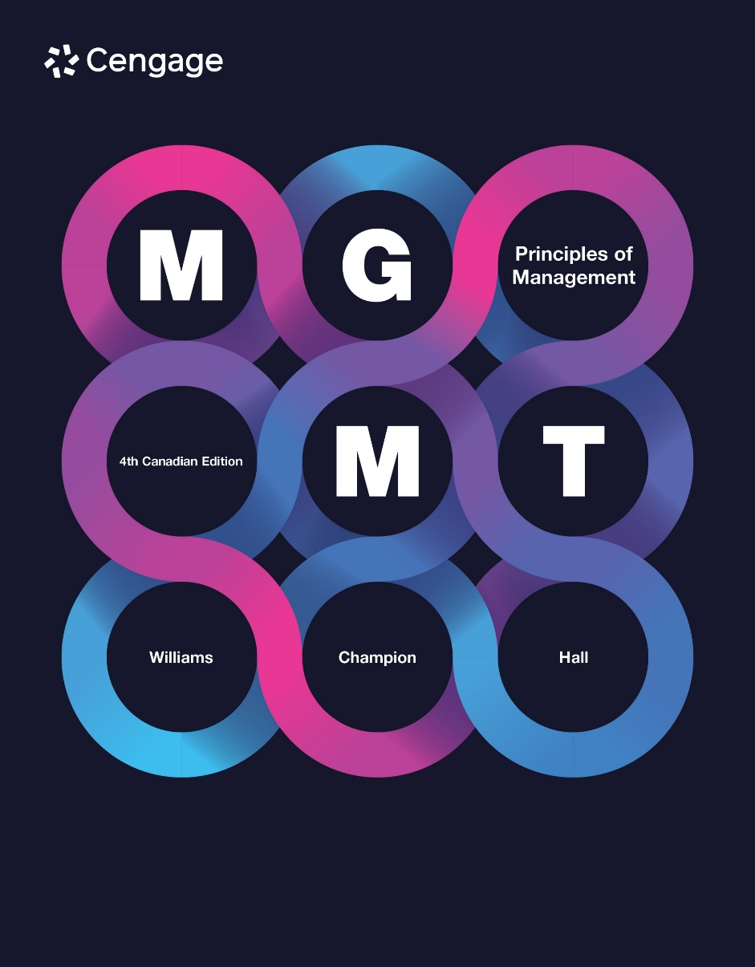

Slide 2
Chapter 9
Leading Teams
LECTURE 11 SEP 2025
Dr IKE

Slide 3
Work Teams
Work teams: A small number of people with complementary skills who hold themselves mutually accountable for pursuing a common purpose, achieving performance goals and improving interdependent work processes.
9-3

Slide 4
The Good and Bad of Using Teams: Advantages
Customer satisfaction
Product and service quality
Employee job satisfaction
Decision making
Multiple perspectives
More alternate solutions
Commitment to decisions
Notes:
Advantages
Teams help businesses increase customer satisfaction in several ways. One way is to create work teams that are trained to meet the needs of specific customer groups. Businesses also create problem-solving teams and employee-involvement teams to study ways to improve overall customer satisfaction and make recommendations for improvements.
Teams help firms improve product and service quality. In contrast to traditional organizational structures where management is responsible for organizational outcomes and performance, one of the primary advantages is that teams take direct responsibility for the quality of the products and services they produce.
Teamwork often leads to increased job satisfaction. One reason teamwork can be more satisfying than traditional work is that it gives workers a chance to improve their skills. This is often accomplished through cross training, in which team members are taught how to do all or most of the jobs performed by other team members. Participation in work teams increases job satisfaction by providing team members unique opportunities that would otherwise not be available.
Teams share advantages of group decision making.

Slide 5

The Good and Bad of Using Teams: Disadvantages
Initially high employee turnover
Social loafing
Disadvantages of group decision making
Groupthink
Inefficient meetings
Minority domination
Lack of accountability
Notes:
Disadvantages
Initially high turnover. Teams aren’t for everyone, and some workers will balk at the responsibility, effort, and learning required in team settings.
Social loafing. Occurs when workers withhold their efforts and fail to perform their share of work. Social loafers count on being able to blend into the background so their lack of effort isn’t easily spotted. Because of team-based class projects, most students already know about social loafers, or “slackers,” who contribute poor, little, or no work.
Disadvantages of group decision making include groupthink, where members of cohesive groups feel pressure not to disagree with one another, leading to the consideration of a limited number of alternative solutions and ultimately poor decisions. Team decision making takes considerable time, and some team members may be unproductive and inefficient. Another pitfall is that one or two people may dominate team discussions, restricting the consideration of problems and solutions. Team members may not feel accountable for the decisions and actions taken by the team.

Slide 6
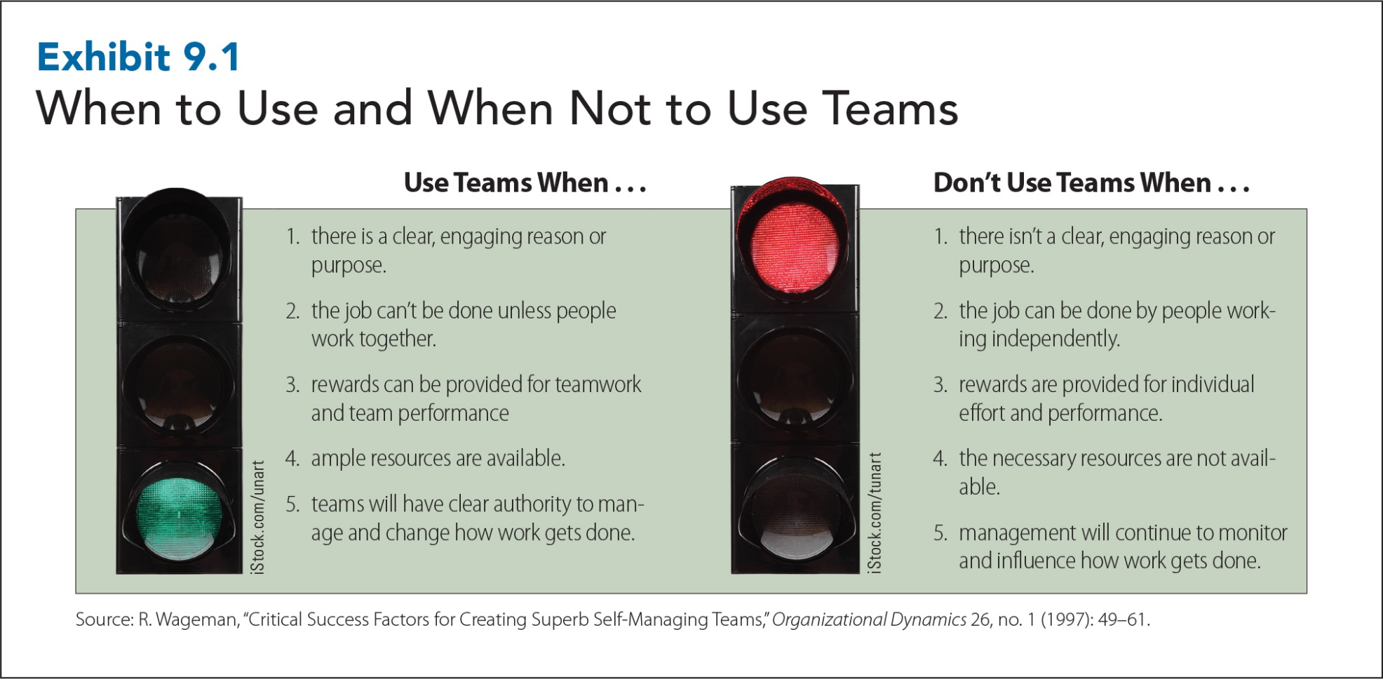
When to Use and When Not to Use Teams PG 181
9-6
Notes:
Teams should be used where there is a clear, engaging reason or purpose for using them. Many companies use teams because it is a popular practice or because they assume that teams can fix all problems. Teams are likely to succeed only if they know why they exist and what they are supposed to accomplish.
Teams should be used when the job can’t be done unless people work together. This means that teams are required when tasks are complex, require multiple perspectives, or require repeated interaction with others to complete. If tasks are simple or don’t require multiple perspectives or repeated interaction with others, then teams should not be used.
Teams should be used when rewards can be provided for teamwork and team performance. Team rewards that depend on team performance versus individual performance are key to rewarding team behaviours and efforts.
Teams should be used when ample resources are available. Resources that teams need include training, sufficient time and space to work together, job-specific tools, and consistent information and feedback concerning teamwork processes and job performance.
A key problem with resources is management resistance. Managers in charge are often reluctant to help teams or turn over resources to them.

Slide 7
Factors That Encourage People to Withhold Effort in Teams PG 181
The presence of someone with expertise
The presentation of a compelling argument
Lacking confidence in one’s ability to contribute
An unimportant or meaningless decision
A dysfunctional decision-making climate
Notes:
The presence of someone with expertise. Team members will withhold effort when another team member is highly qualified to make a decision or comment on an issue.
The presentation of a compelling argument. Team members will withhold effort if the arguments for a course of action are very persuasive or similar to their own thinking.
Lacking confidence in one’s ability to contribute. Team members will withhold effort if they are unsure about their ability to contribute to discussions, activities, or decisions. This is especially the case for high-profile decisions.
An unimportant or meaningless decision. Team members will withhold effort by mentally withdrawing or adopting a “who cares” attitude if decisions don’t affect them or their units, or if they don’t see a connection between their efforts and their team’s successes or failures.
A dysfunctional decision-making climate. Team members will withhold effort if other team members are frustrated or indifferent or if a team is floundering or disorganized.
Sources: A. Puni, C.B. Agyemang, and E.S. Asamoah (2016), “Leadership Styles, Employee Turnover Intentions and Counterproductive Work Behaviours,” International Journal of
Innovation and Research (5)1. Accessed online 12 February 2016 at https://scholar.google.ca/scholar?q=Leadership+Styles,+Employee+Turnover+Intentions+and+Counterp
roductive+Work+Behaviours&hl=en&as_sdt=0&as_vis=1&oi=scholart; A. Powell, J. Galvin, and G. Piccoli (2006), “Antecedents to Team Member Commitment from Near and
Far: A Comparison between Collocated and Virtual Teams,” Information Technology & People Vol. 19 Iss: 4., available online at https://www.proquest.com/docview/222394908

Slide 8
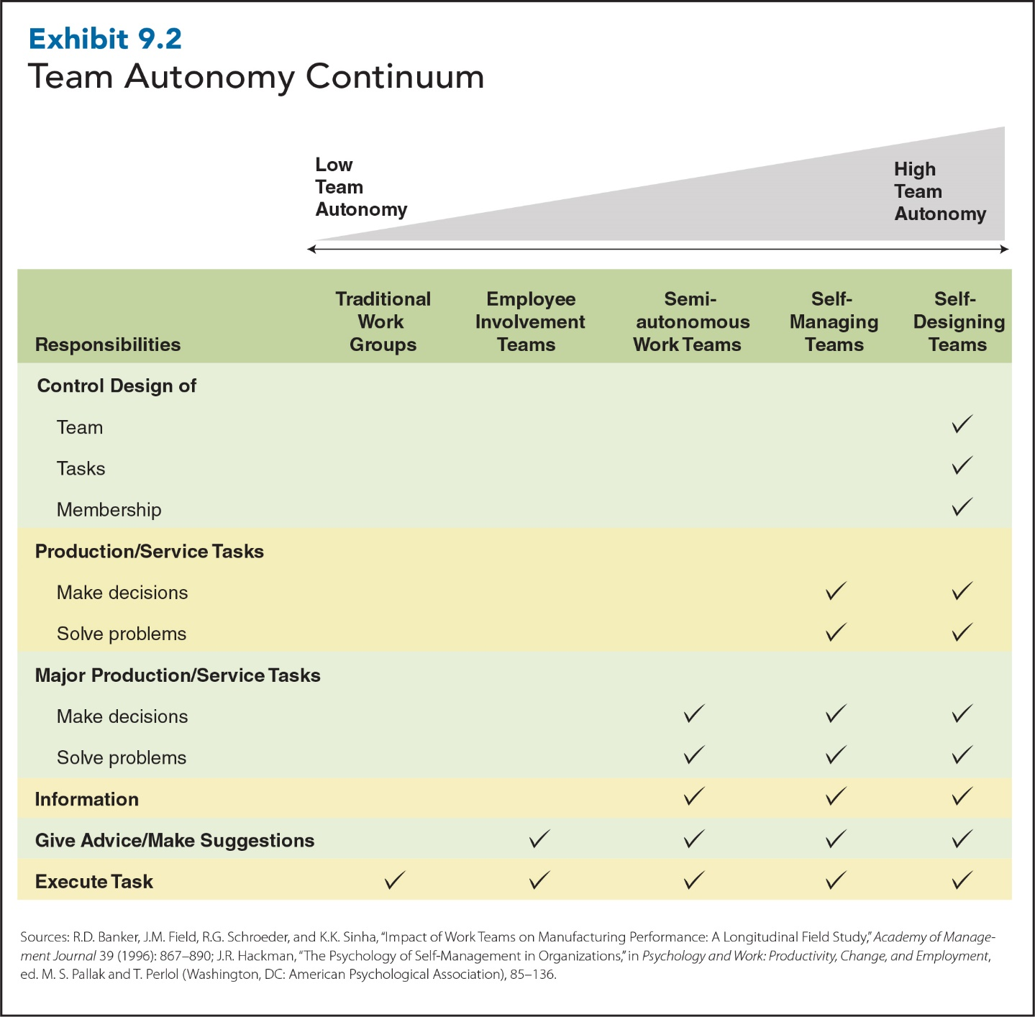
8
9-8
Notes:
This exhibit shows how five kinds of teams differ in terms of autonomy. Autonomy is the degree to which workers have the discretion, freedom, and independence to decide how and when to do their work.
Traditional work groups: two or more people work together to achieve a shared goal
Employee involvement teams: have more autonomy; meet on company time on a weekly/monthly basis to provide advice or make suggestions to management concerning specific issues such as plant safety, customer relations, or product quality
Semi-autonomous work groups: provide advice/suggestions to management; also have authority to make decisions/solve problems related to the major tasks required to produce the product/service
Self-managing teams (also known as self-directed teams): differ from semi-autonomous work groups in that team members manage/control all major tasks that are directly related to the production of the product/service without first getting approval from management
Self-designing teams: have characteristics of self-managing team; also control and change design of team itself, tasks it does, how and when it does them, as well membership of team

Slide 9
Special Kinds of Teams
Cross-Functional Teams
Virtual Teams
Project Teams
Notes:
Cross-functional teams: intentionally composed of employees from different functional areas of an organization. Because members have different functional backgrounds, education, and experience, cross-functional teams attack problems from multiple perspectives and generate more ideas and alternative solutions, which are important when trying to innovate or do creative problem solving. Cross-functional teams are used almost anywhere in an organization and are often used in conjunction with matrix and product organizational structures.
Virtual teams: groups of geographically and/or organizationally dispersed coworkers who use a combination of telecommunications and information technologies to accomplish an organizational task. Members of virtual teams rarely meet face to face. The idea of virtual teams is relatively new and has been made possible by advances in communications and technology such as email, the World Wide Web, videoconferencing, and other group communication products.
Project teams: created to complete specific, one-time projects and tasks within a limited time. Project teams are often used to develop new products, to significantly improve existing products, to roll out new information systems, or to build new factories or offices. A project team is typically led by a project manager, who has overall responsibility for planning, staffing, and managing the team.

Slide 10
Special Kinds of Teams
Cross-Functional
Employees from different functional areas
Generate more ideas and alternative solutions
Used in conjunction with matrix and product organizational structures
Notes:
Cross-functional teams: intentionally composed of employees from different functional areas of an organization. Because members have different functional backgrounds, education, and experience, cross-functional teams attack problems from multiple perspectives and generate more ideas and alternative solutions, which are important when trying to innovate or do creative problem solving. Cross-functional teams are used almost anywhere in an organization and are often used in conjunction with matrix and product organizational structures.

Slide 11
Special Kinds of Teams
Virtual
Select self-starters and strong communicators
Provide frequent feedback
Keep team upbeat and action-oriented
Empower virtual teams
Notes:
Virtual teams: groups of geographically and/or organizationally dispersed coworkers who use a combination of telecommunications and information technologies to accomplish an organizational task. Members of virtual teams rarely meet face to face. The idea of virtual teams is relatively new and has been made possible by advances in communications and technology such as email, the World Wide Web, videoconferencing, and other group communication products.

Slide 12
Special Kinds of Teams
Project
One-time projects within a limited time
Promote flexibility
Notes:
Project teams: created to complete specific, one-time projects and tasks within a limited time. Project teams are often used to develop new products, to significantly improve existing products, to roll out new information systems, or to build new factories or offices. A project team is typically led by a project manager, who has overall responsibility for planning, staffing, and managing the team.

Slide 13
Work Team Characteristics
Team
Norms
Team
Cohesiveness
Team
Size
Team
Conflict
Team
Development
13
9-13
Notes:
Managers who are familiar with the stages of team development and with other important team characteristics are better prepared to manage predictable changes that occur when companies make the switch to team-based structures.

Slide 14
Team Norms
Team norms: Informally agreed-on standards that regulate everyday team behaviours
Studies indicate that norms are one of the most powerful influences on work behaviour.
Effective work teams develop norms about the quality and timeliness of job performance, absenteeism, safety, and expression of ideas.
9-14
Notes:
Over time, teams develop norms, informally agreed-on standards that regulate team behaviour. Norms are valuable because they let team members know what’s expected of them.
Studies show that norms are often associated with positive outcomes, such as stronger organizational commitment, more trust in management, and stronger job and organizational satisfaction.
Effective work teams develop norms about the quality and timeliness of job performance, absenteeism, safety, and the honest expression of ideas and opinions.
The power of norms comes from fact that they regulate everyday kinds of behaviours that allow teams to function effectively. Since team norms typically develop early in the life of a team, results show how important it is for teams to establish positive norms and influences on work behaviour.
Team norms can have negative impact as well. The longer employees were members of a team with negative norms, and the more frequently they interacted with their teammates, the more likely individual team members were to perform negative behaviours.

Slide 15
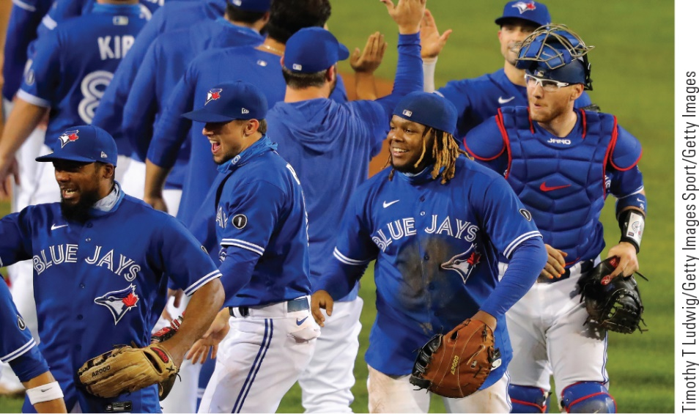
Team Cohesiveness
Why:
Retain their members
Promote cooperation
Have high levels of performance
How:
All members attending meetings
Rearranging work schedules
Creating common workspaces
Engaging in non-work activities
Notes:
Cohesiveness: the extent to which team members are attracted to the team and motivated to remain in it. The level of cohesiveness that exists in a group is important for several reasons. Cohesive groups have a better chance of retaining members. As a result, cohesive groups typically experience lower turnover. Team cohesiveness promotes cooperative behaviour, generosity, and a willingness on the part of team members to assist one another. When team cohesiveness is high, team members are more motivated to contribute to the team because they want to gain approval of other team members. Studies established that cohesive teams are consistently better-performing teams. Cohesive teams quickly achieve high levels of performance. Teams low in cohesion take longer to reach the same levels of performance.
What can be done to promote team cohesiveness?
Make sure team members are present at team meetings and activities. Team cohesiveness suffers when members are allowed to withdraw from the team and miss team meetings and events.
Create additional opportunities for teammates to work together by rearranging work schedules and creating common workspaces. When task interdependence is high and team members have lots of chances to work together, team cohesiveness tends to increase.
Engage in non-work activities as a team to help build cohesion.

Slide 16
Team Size
Performance
Size
16
Notes:
There appears to be a curvilinear relationship between team size and performance. Small or large teams may not perform as well as moderately sized teams. For most teams, the right size is six to nine members. This size is conducive to high team cohesion and has a positive effect on team performance. Teams of this size are small enough for team members to get to know one another and for each member to have an opportunity to contribute in a meaningful way to the success of the team. They are also large enough to take advantage of team members’ diverse skills, knowledge, and perspectives. It is easier to instil a sense of responsibility and mutual accountability in teams of this size.
When teams get too large, team members find it difficult to get to know one another and may go into smaller subgroups. When that occurs, subgroups can argue or disagree, weakening overall team cohesion. As teams grow, there is a greater chance of minority domination, where a few team members dominate team discussions. Large teams face logistical problems, such as finding an appropriate time and place to meet. The incidence of social loafing, discussed earlier in the chapter, is higher in large teams. All of these factors indicate how large teams can have a negative impact on team performance.
It is also important that teams not be too small. Teams with too few people may lack the diversity of skills and knowledge found in larger teams. Teams that are too small are unlikely to gain the advantages of team decision making (such as multiple perspectives, generating more ideas and alternative solutions, and stronger commitment) found in larger teams.

Slide 17

Team Conflict
C-Type Conflict (Cognitive)
Focuses on problems and issues
Associated with improvements in team performance
A-Type Conflict (Affective)
Emotional, personal disagreements
Associated with decreases in team performance
Notes:
Conflict and disagreement are inevitable in most teams. People who work together are going to disagree about how things get done. What causes conflict in teams? Anything can lead to conflict: casual remarks may unintentionally offend a team member or there may be fighting over scarce resources. The primary cause of team conflict is disagreement over team goals or priorities. Common causes of team conflict include disagreements over task-related issues, interpersonal incompatibilities, and fatigue.
The key to dealing with team conflict is not to avoid conflict but to make sure teams experience the right kind of conflict.
Chapter 4 discusses c-type conflict (cognitive conflict), which focuses on problem- and issue-related differences of opinion, and a-type conflict (affective conflict), which refers to emotional reactions that can occur when disagreements become personal rather than professional. Cognitive conflict is strongly associated with improvements in team performance, while affective conflict is strongly associated with decreases in team performance.
What can managers do to manage team conflict? Managers need to realize that emphasizing cognitive conflict alone is not enough. Studies show that cognitive and affective conflicts often occur together in the same teams. Sincere attempts to reach agreement on a difficult issue can deteriorate from cognitive to affective conflict if the discussion turns personal and tempers and emotions flare. Cognitive conflict is the better approach to take; efforts to engage in cognitive conflict should be approached with caution.

Slide 18
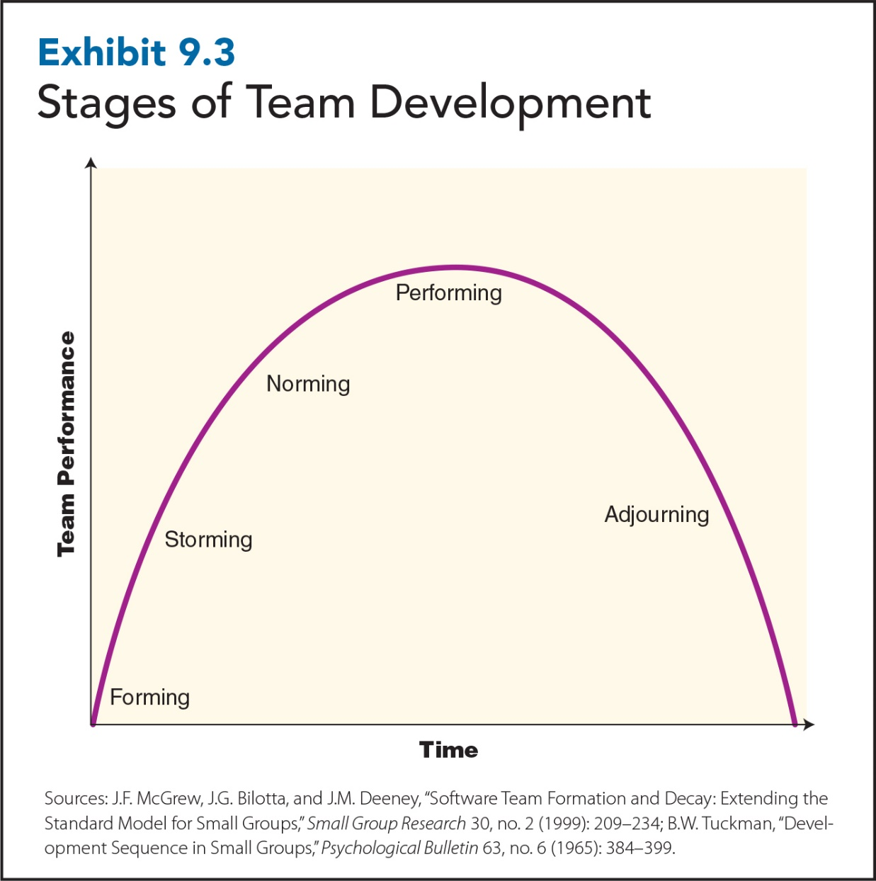
9-18
Notes:
As teams develop and grow, they pass through four stages of development:
Forming: initial stage of team development. In this getting-acquainted stage, team members first meet one another, form impressions, and try to get a sense of what it will be like to be part of the team.
Conflicts and disagreements often characterize the second stage of team development: storming. As team members begin working together, different personalities and work styles may clash. Team members become more assertive at this stage and more willing to state opinions.
Norming, the third stage, is when team members begin to settle into their roles as team members. Positive team norms will have developed by this stage, and teammates should know what to expect from one another. Petty differences should be resolved, friendships have developed, and group cohesion is relatively strong.
In the last stage, performing, team performance improves because the team has finally matured into an effective, fully functioning team. Members should be fully committed to the team and think of themselves as “members of a team,” not just ”employees.”
If not managed well, performance may decline as teams progress through adjourning, which includes three stages: de-norming, de-storming, and de-forming.
*De-norming: the reversal of the norming stage, when team performance begins to decline as the size, scope, goal, or members of the team change
*De-storming, the reversal of the storming phase, when a team’s comfort level decreases
*De-forming, the reversal of the forming stage, when team members position themselves to gain control of pieces of the team. Team members begin to avoid one another and isolate themselves from team leaders. Team performance rapidly declines as the team quits caring about even minimal requirements of team performance.

Slide 19
Enhancing Work Team Effectiveness
Effectiveness
Setting Team Goals and Priorities
Selecting Team Members
Team Compensation
Team Training
19
Notes:
Making teams work is a challenging and difficult process. Companies can increase the likelihood of team success by managing the setting of team goals and priorities, and by managing the way work team members are selected, trained, and compensated.

Slide 20

Team Compensation and Recognition
The level of reward must match the level of performance.
Methods of compensating team participants:
Skill-based pay
Gainsharing
Non-financial rewards
Notes:
Companies need to carefully choose their team compensation plan and fully explain how teams will be rewarded. One requirement: the level of rewards (individual vs. team) must match the level of performance (individual vs. team) for team compensation to work.
There are three methods of compensating employees for team participation and accomplishments:
Skill-based pay: programs pay employees for learning additional skills/ knowledge; programs encourage employees to acquire additional skills needed to perform jobs within the team.
Gainsharing: programs in which companies share the financial value of the performance gains (such as productivity, cost savings, and quality) with the workers.
Non-financial rewards: can range from vacation trips to T-shirts, plaques, coffee mugs; especially effective when coupled with management recognition.
Non-financial rewards tend to be most effective when teams or team-based interventions, such as total quality management (Chapter 17), are first introduced.
Which team plan should your company use? Skill-based pay is the most effective for self-managing and self-directing teams performing complex tasks. The more each team member knows and can do, the better the whole team performs.
Gainsharing works best in relatively stable environments where employees can focus on improving productivity, cost savings, and the quality of the current work system.

